Slide 1

Capstone Project

Slide 2



Personal BACKGROUND
(Name, Past Experience, Qualification, Career Summary)
Name : Mohamed Showqath N
Past Experience : Fresher
Qualification : B.E. Computer Science And Engineering
Career Summary : I am a recent graduate in Computer Science and Engineering with a strong passion for backend development. Currently, I am deepening my skills in backend technologies, focusing on Java and Spring Boot. My goal is to build robust, scalable, and efficient backend systems. I am eager to contribute to dynamic development teams and apply my academic knowledge and practical skills to solve real-world problems.
www.collaberadigital.com

Slide 3


Key Takeaways/Learnings from the Program (HTD)
Java Fundamentals:
Strengthened understanding of object-oriented programming principles in Java.
Gained proficiency in core Java concepts such as data structures, multithreading, exception handling, and I/O operations.
Spring Boot Framework:
Acquired in-depth knowledge of building RESTful web services using Spring Boot.
Mastered dependency injection, Spring Data JPA for database interactions, and the use of Spring Security for securing applications
Microservices Architecture:
Understood the design and implementation of microservices using Spring Boot.
Explored techniques for service communication (e.g., REST APIs) and distributed system management (e.g., service discovery and load balancing).
Problem-Solving:
Developed strong problem-solving abilities by tackling real-world challenges in designing and implementing the online shopping system.

Slide 4

Problem Statement of the Capstone Project
Create an online shopping platform with real time inventory management , to avoid an issues such as overselling, stockouts, and delayed order fulfilment . This results in a poor shopping experience for customers and operational inefficiencies for businesses .

Slide 5
Introduction to Spring Boot
Title: Introduction to Spring Boot
Content:
What is Spring Boot?
Java-based framework for creating stand-alone, production-ready applications.
Provides pre-configured templates for faster development.
Key Features of Spring Boot in the Project
Title: Key Features of Spring Boot in the Project
Content:
Entity Management: JPA Entities for data representation.
RESTful Controllers: API endpoints for customer and product management.
Service Layer: Business logic handling (e.g., order processing).
Repository Layer: CRUD operations for data persistence.
DevTools: Hot swapping and live reload for faster testing.
Why Use Spring Boot for Online Shopping Projects?
Content:
Rapid Development: Simplified setup and auto-configuration.
Microservices Architecture: Scalable and modular design.
RESTful APIs: Efficient handling of web services.
Database Integration: Seamless interaction with databases.
Security: Built-in Spring Security for data protection.

Slide 6

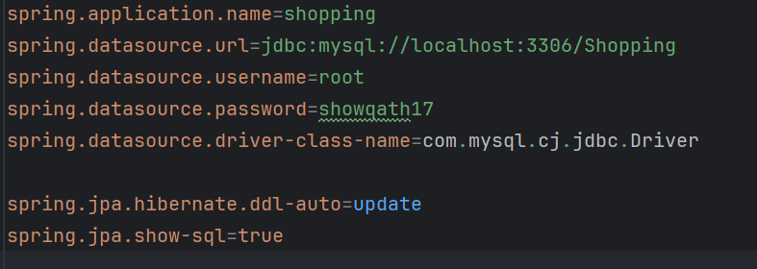
Introduction to MySQL:
What is MySQL?
MySQL is an open-source relational database management system (RDBMS).
It uses Structured Query Language (SQL) to manage data.
Popular for its performance, reliability, and ease of use.

Slide 7
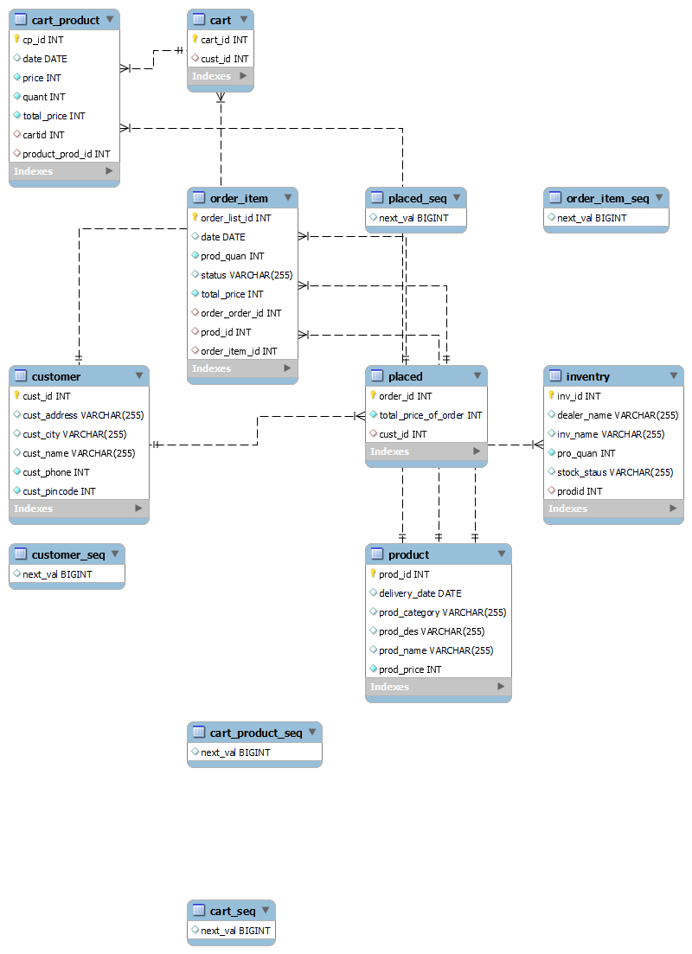

Slide 8
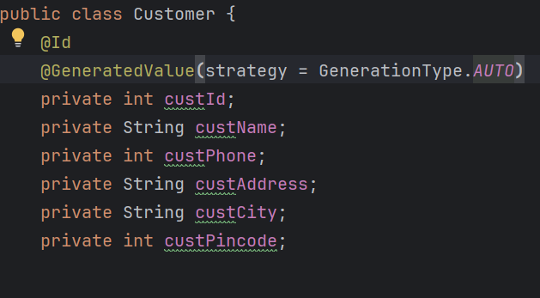
Overview of the Customer Entity:
The Customer class represents a typical customer entity in a Spring Boot application.
Each customer has the following attributes:
customerId : A unique identifier for each customer, automatically generated by the system using @GeneratedValue(strategy = GenerationType . AUTO) .
customerName: The name of the customer.
custPhone: The phone number of the customer.
custAddress: The address where the customer resides.
custCity: The city in which the customer is located.
custPincode: The postal code associated with the customer's address.
This class is annotated with @Id to designate custId as the primary key
for the entity.

Slide 9
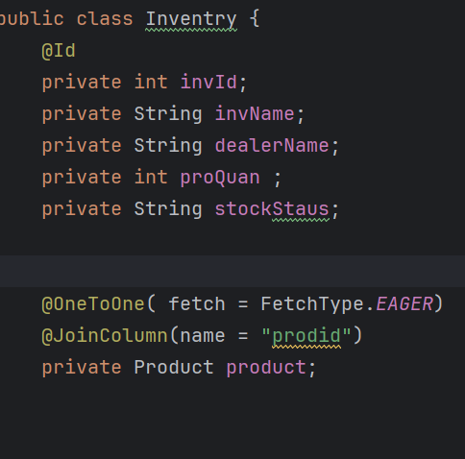
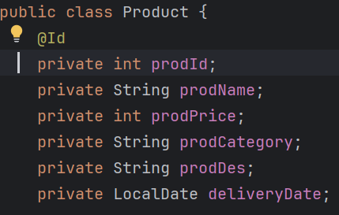
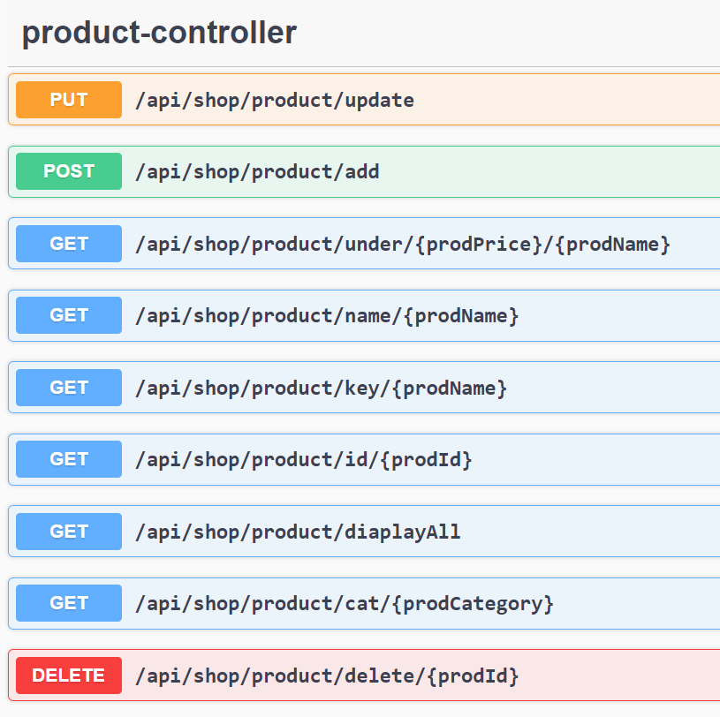
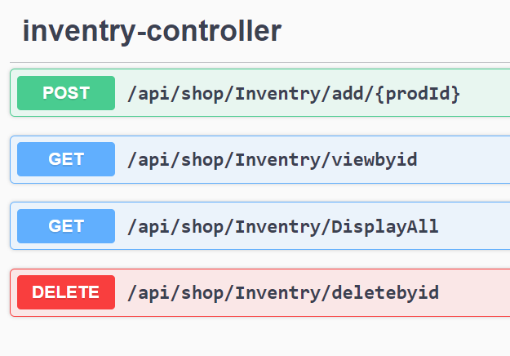
Important areas of the Project with screenshots

Slide 10
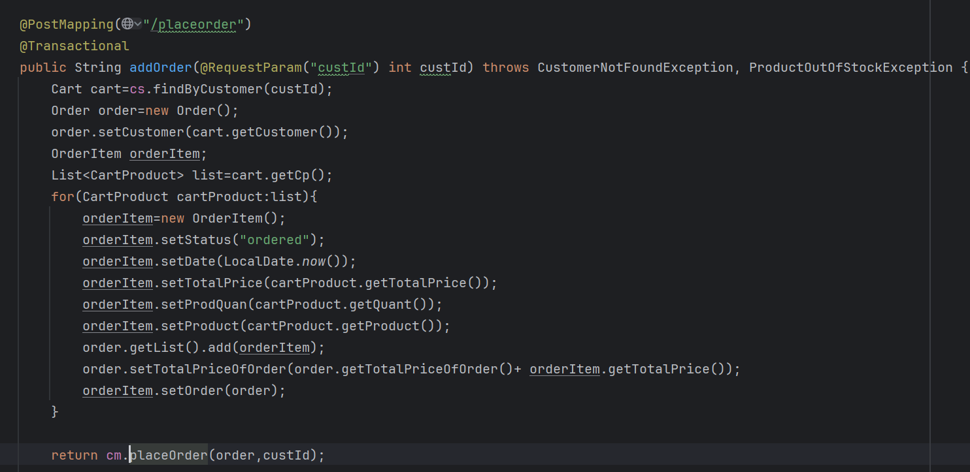
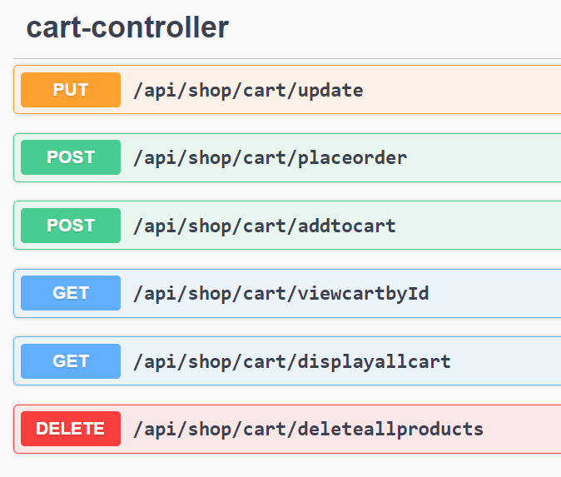
Important areas of the Project with screenshots

Slide 11
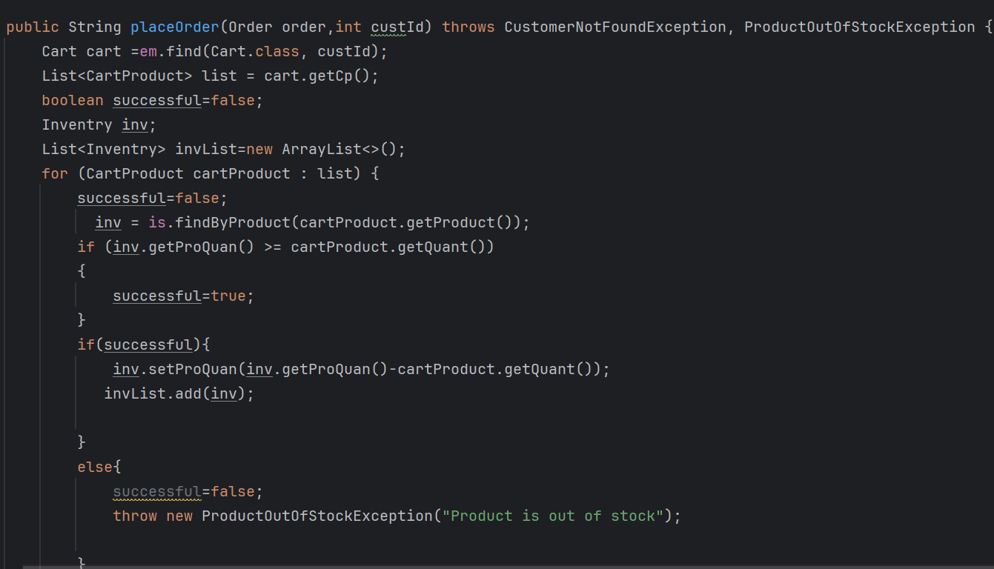
Important areas of the Project with screenshots

Slide 12
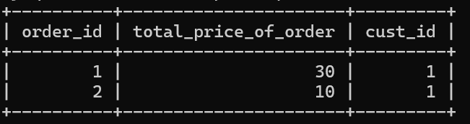
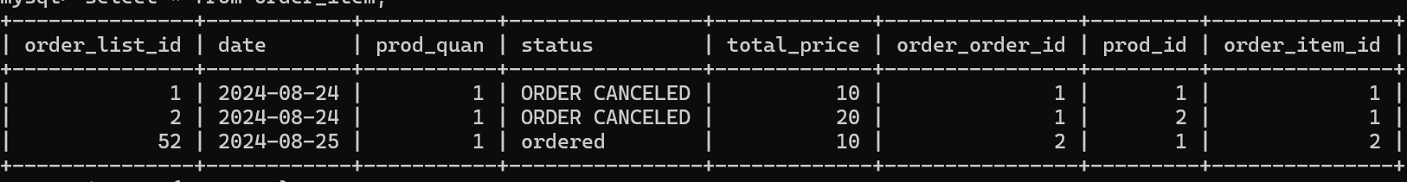
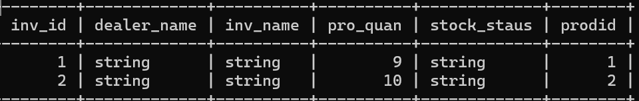

Slide 13
Summary of the Online Shopping Project:
Efficiently powered the backend with its rapid development features, RESTful APIs, and support for microservices architecture and monolithic architecture.
Enabled smooth management of core functionalities like customer management, product catalog , and order processing through well-structured layers (Controller,
Service, Repository).
Provided a reliable and scalable database solution for handling customer data, product information, and order details.
Supported seamless data interactions and ensured high performance with optimized queries and proper indexing.
Key Achievements:
Developed a responsive and easy-to-navigate online shopping platform.
Robust Data Management
Efficient handling of large datasets, ensuring quick access and modification of data like customer profiles, product listings, and orders.
Scalability and Performance
Expansion of Features:
Further enhancement of the product catalog and customer experience through additional features like personalized recommendations, advanced search filters, and real-time inventory tracking.
Conclusion

Slide 14
Thank You

